Slide 1

Apex Basics Dev Session
Triggers, Asynchronous Apex
BearingPoint 2021

Slide 2




Project overview
World Wildlife animal adoption system.
World Wildlife organization (WWF) offers it’s customers to virtually adopt different animals from across the planet. Adoption is in form of monthly subscription payments from customers that wants to donate. WWF uses these funds to help these “adopted” animals to strive and survive in modern world.
WWF uses Salesforce to manage information about their donors and their adoption subscriptions.
They want to provide some motivation to attract new donors and keep existing ones. This project will go through implementing several User Stories to help WWF achieve their goal.

Slide 3
WWF Basic Data Model

Slide 4








New Subscription duplicities
WWF would like to prevent duplicates of subscriptions. One user should have only one active adoption per animal. The check should be performed when creating new or updating existing Adoption.
Use Case 1

Slide 5

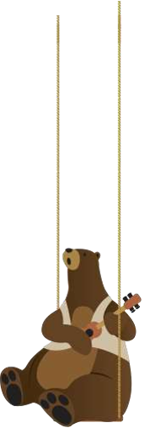
Question 1
As a developer, which of the following Apex technologies would you use to implement the first use case?
WWF would like to prevent duplicates of subscriptions. One user should have only one active adoption per animal. The check should be performed when creating new or updating existing Adoption.
A) Schedulable C) Trigger
B) Batch Class D) Future

Slide 6


Apex Trigger
Topics to cover
On SObject
Naming Convention [SObject Name without __c]Trigger.trigger
Trigger Operation Types
Before / After
Insert, Update, Delete, Undelete
TriggerOperation Enum case instead of else ifs
One Trigger per SObject
New / Old | List / Map
Keep logic itself outside of Trigger - helper class [Trigger Name]Helper.cls

Slide 7

Question 2
What is the easiest way to compare new value of record field with old value inside an Apex Trigger?
A) Get old record from Trigger.oldMap
B) Select the old record
C) record.old() method
D) Get old record from Trigger.old

Slide 8

Handle expiring subscriptions
Subscriptions can expire and so they have to be controlled every day at midnight (0:00), solution should be scalable and able to handle large volumes of expired subscriptions.
Logic should also handle subscriptions that are about to expire. Implementation logic should be following.
If the subscription is going to expire in 10 days, donor should be notified via email. (Prepare the logic, but do not implement email sending.)
If the subscription has expired, set the subscription status to “Expired".
Use Case 2

Slide 9


Question 3
Which of the following technologies would you use to programmatically implement Use Case 2? (multiple choice - choose 2)
A) Apex Trigger
B) Queueable
C) Schedulable
D) Future
E) Batch Class
F) Invocable Method
Can also be achieved by flow

Slide 10

Batch Class
Topics to cover
Implements Database.Batchable interface
start () - QueryLocator X Iterable, execute(), finish() methods
Database.Stateful for persistent attributes
Callouts from batch
Submit batch jobs for execution

Slide 11
Schedulable Class
Topics to cover
Implements Schedulable interface
Execute method
cron expression
System.schedule()

Slide 12
Question 4
TODO RELATED TO BATCH CLASS
A)
B)
C)
D)

Slide 13
Unit Testing
Apex unit tests for triggers, batches and schedulable
Prepare data => startTest(); => call tested method => stopTest(); => verify result by asserts
Every non test class should have corresponding _Test class
Best practice is to write separate unit tests for every public method in class + more complicated private methods (@TestVisible)
Testing Triggers
Test Class for trigger helper
Test every method separately
Add additional tests with DML to cover the trigger part
Testing Batches
Database.executeBatch(); must be within startTest(); and stopTest(); to ensure asynchronous execute run is finished before asserts
Testing Schedulable
stopTest() enforces all future scheduled jobs to run immediately
Assert results from AsyncApexJob to ensure job is scheduled

Slide 14
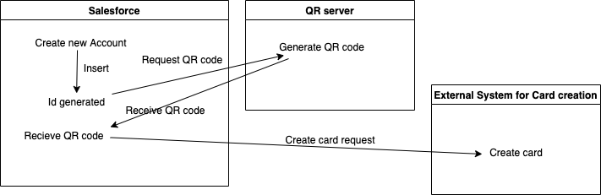
Generate and distribute QR codes
WWF has physical stores, where people can buy plushes, postcards, toys and other things with animal theme. They want to have a bonus program for shoppers that are also registered as donors, they should identify via QR code containing their ID in Salesforce. WWF also uses external system for creating bonus program cards, the card should be created with generated QR code.
After new Account is created API for creating QR called needs to be called (https://api.qrserver.com/v1/create-qr-code/?size=150x150&data={AccountId}). This QR code should be sent with the request to create new Donator card in external system.
Use Case 3

Slide 15
Question 4
Which of the following technologies will be used to programmatically implement Use Case 4
A) Batch
B) Invocable method
C) Queueable
D) Future

Slide 16
Queueable Class
Topics to cover
Asynchronous
Implements Queueable interface and execute() method
System.enqueueJob();
Chain jobs by calling enqueueing one Queueable from another

